Slide 1
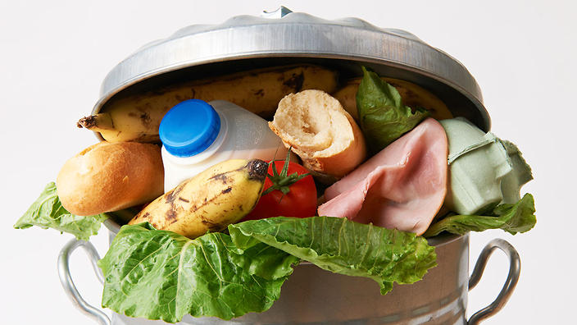


DEVELOPMENT FOR A BETTER FUTURE
MODULE 7
FOOD LOSS AND WASTE
Year 9 and 10
Free for Educational Use in Australian Schools
Making a Global Difference: Development for a Better Future © 2024 by Crawford Fund is licensed under CC BY-NC 4.0

Slide 2
Module 7: Food Loss and Waste
Inquiry Question
  What are the greatest challenges in Food Loss in developing countries and how can we contribute to a greater impact on food and nutrition security in these countries?
Guiding Questions
  What is the difference between Food Loss and Food Waste? How do they impact Asia and Oceania?
  What is being done to address this issue and how is Australia a part of the solution?
  How can we support the work of ACIAR in bringing attention to this challenge to our local community?

Slide 3
Students will:
Review
Videos and social media posts from leading international organisations.
Identify the business or economic challenge in food loss and waste in Agriculture.
Gather relevant and reliable data and information from a range of digital, online and print sources
Identify
Generate a range or viable options in response to the business/ economic challenges/barriers of food loss and waste.
Criteria of success to assess options presented by the class groups.
Produce
Plan and produce an awareness-raising campaign (social media post, video or PowerPoint), demonstrating your knowledge and understanding of the business or economic challenge, to educate a specific audience about the challenge and solution/s on Food Loss and Waste.
Activate
Load your campaign onto an online platform to generate awareness of the challenges and opportunities for International Food and Waste Day – 29 September.
Share prior knowledge
Share their knowledge and understanding of the Food loss and waste.

Slide 4

What do you know?
Consider these questions
  What is the difference between food loss and food waste?
  Why is it important for a sustainable world?
  What are the sustainable development goals?
  Do Australians have to worry about it?
Discuss as a class and record your ideas on the mind maps to show the challenges and opportunities for food loss and food waste.

Slide 5
Food Loss Mind Map - Challenges and Opportunities
Topic prompts:
More prevalent in developing or developed countries?
Transport
Storage and/or refrigeration
Aesthetics
Gender
Education of farmers/consumers
Technology
Excessive purchasing
Attitude of disposal v. reusing
Climate change
Pests and disease
Processing animals or crops
Food Loss

Slide 6
Food Waste Mind Map – challenges and opportunities
Topic prompts:
More prevalent in developing or developed countries?
Transport
Storage and or refrigeration
Aesthetics
Gender
Education of farmers/consumers
Technology
Excessive purchasing
Attitude of disposal v. reusing
Climate change
Pests and disease
Processing animals or crops
Food Waste

Slide 7
What do you know?
Research food loss and waste and add your learning to your mind maps (use slides 8 – 17 to support your learning). As you watch the video or read the information, think about who the audience is?
Create a food waste choropleth map for Asia.
You will be using this information to create an awareness-raising campaign (social media strategy, video or PowerPoint), for International Day of Awareness of Food and Waste –
29th September, to educate your selected audience.
Define the success criteria for developing your campaign.
Share online.

Slide 8
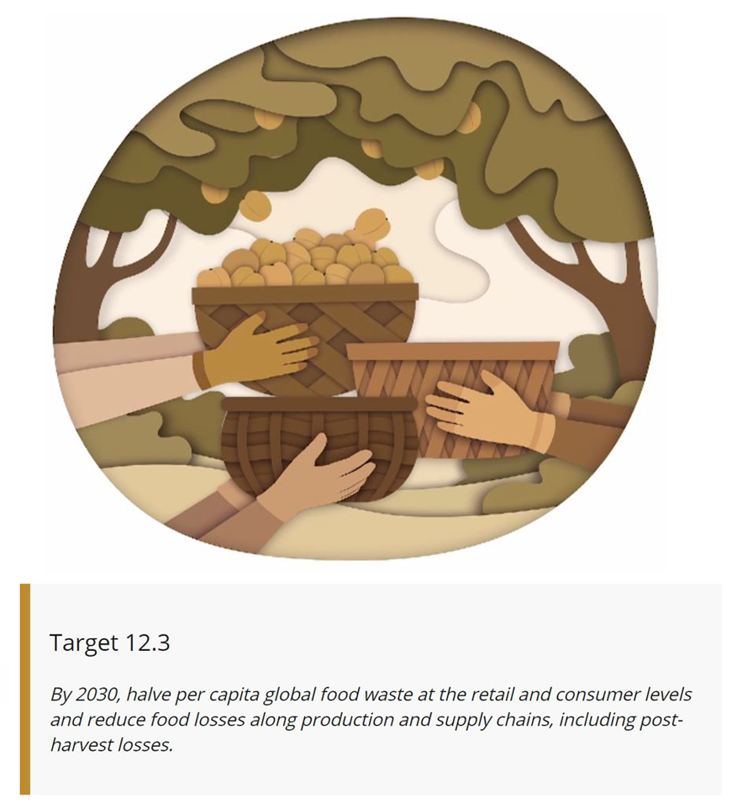

Sustainable Development Goals
More information on the Sustainable Development Goals are at the end of this lesson.
http://www.fao.org/sustainable-development-goals/indicators/12.3.1/en/

Slide 9
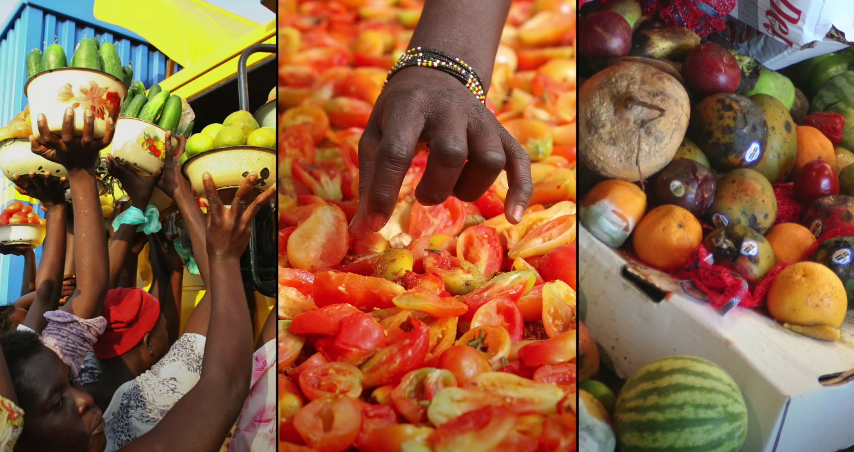
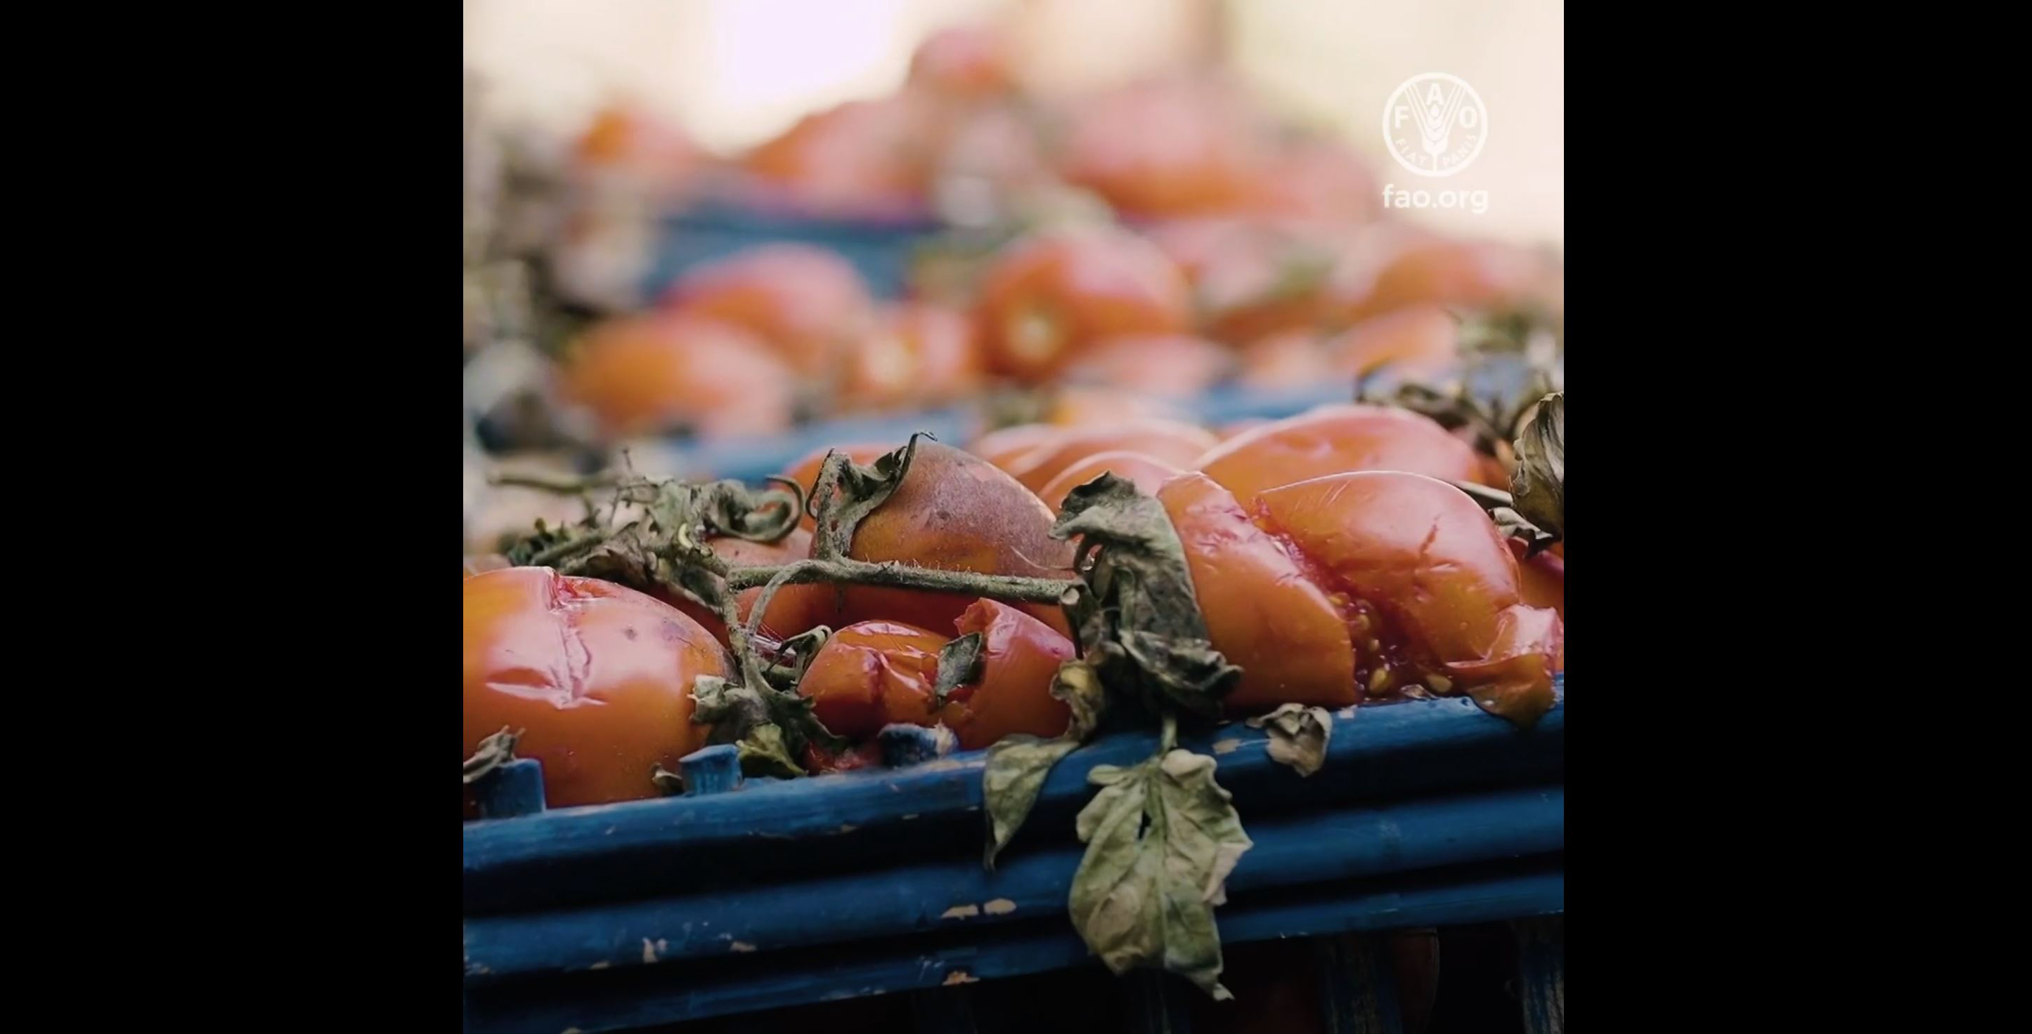
Food loss and waste
Food Loss and Food Waste
https://www.youtube.com/watch?v=pxoz88-GXyk
2020 International Day of Awareness of Food Loss and Waste
https://www.youtube.com/watch?v=qqK5kS8c59g&t=7s

Slide 10
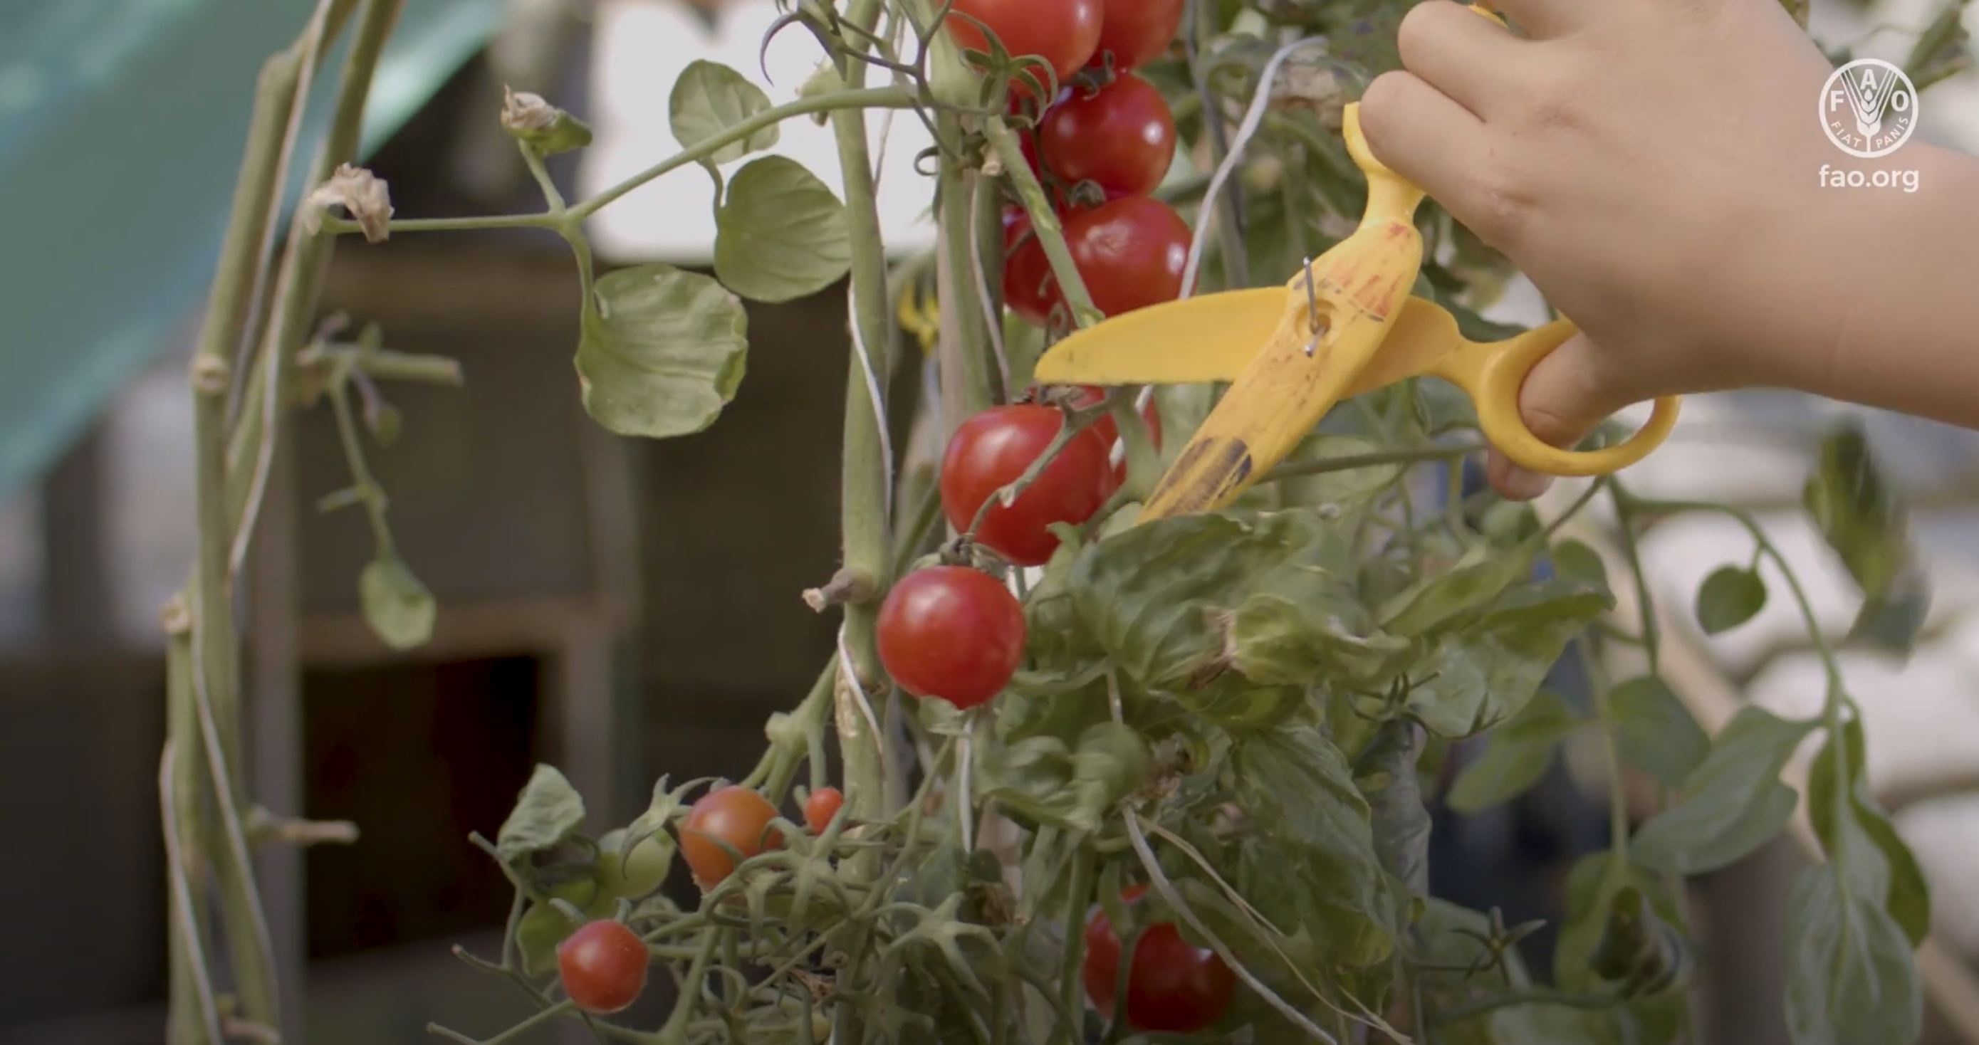
Food loss and waste
Reducing food loss and waste is critical to achieving a sustainable world
Credit: FAO https://www.youtube.com/watch?v=H_YjtkKTgu0

Slide 11
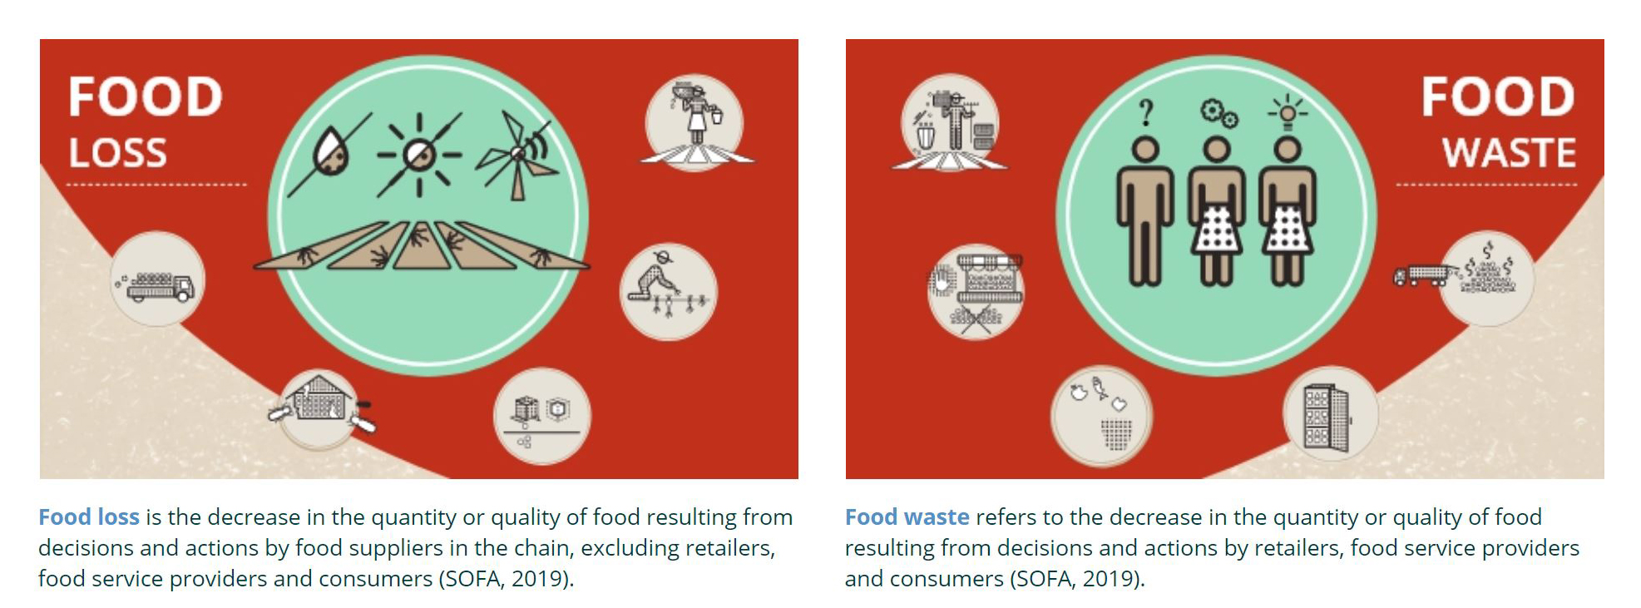
Food and Agriculture Organisation of the United Nations - FAO
Credit: FAO http://www.fao.org/platform-food-loss-waste/en

Slide 12
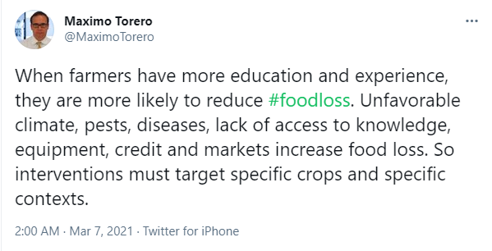
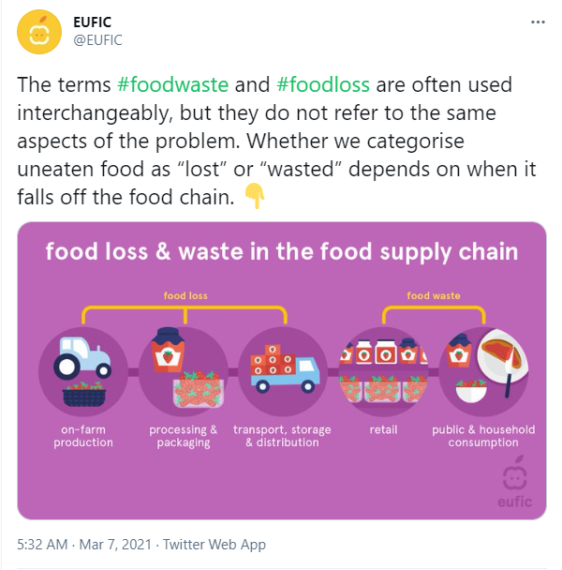
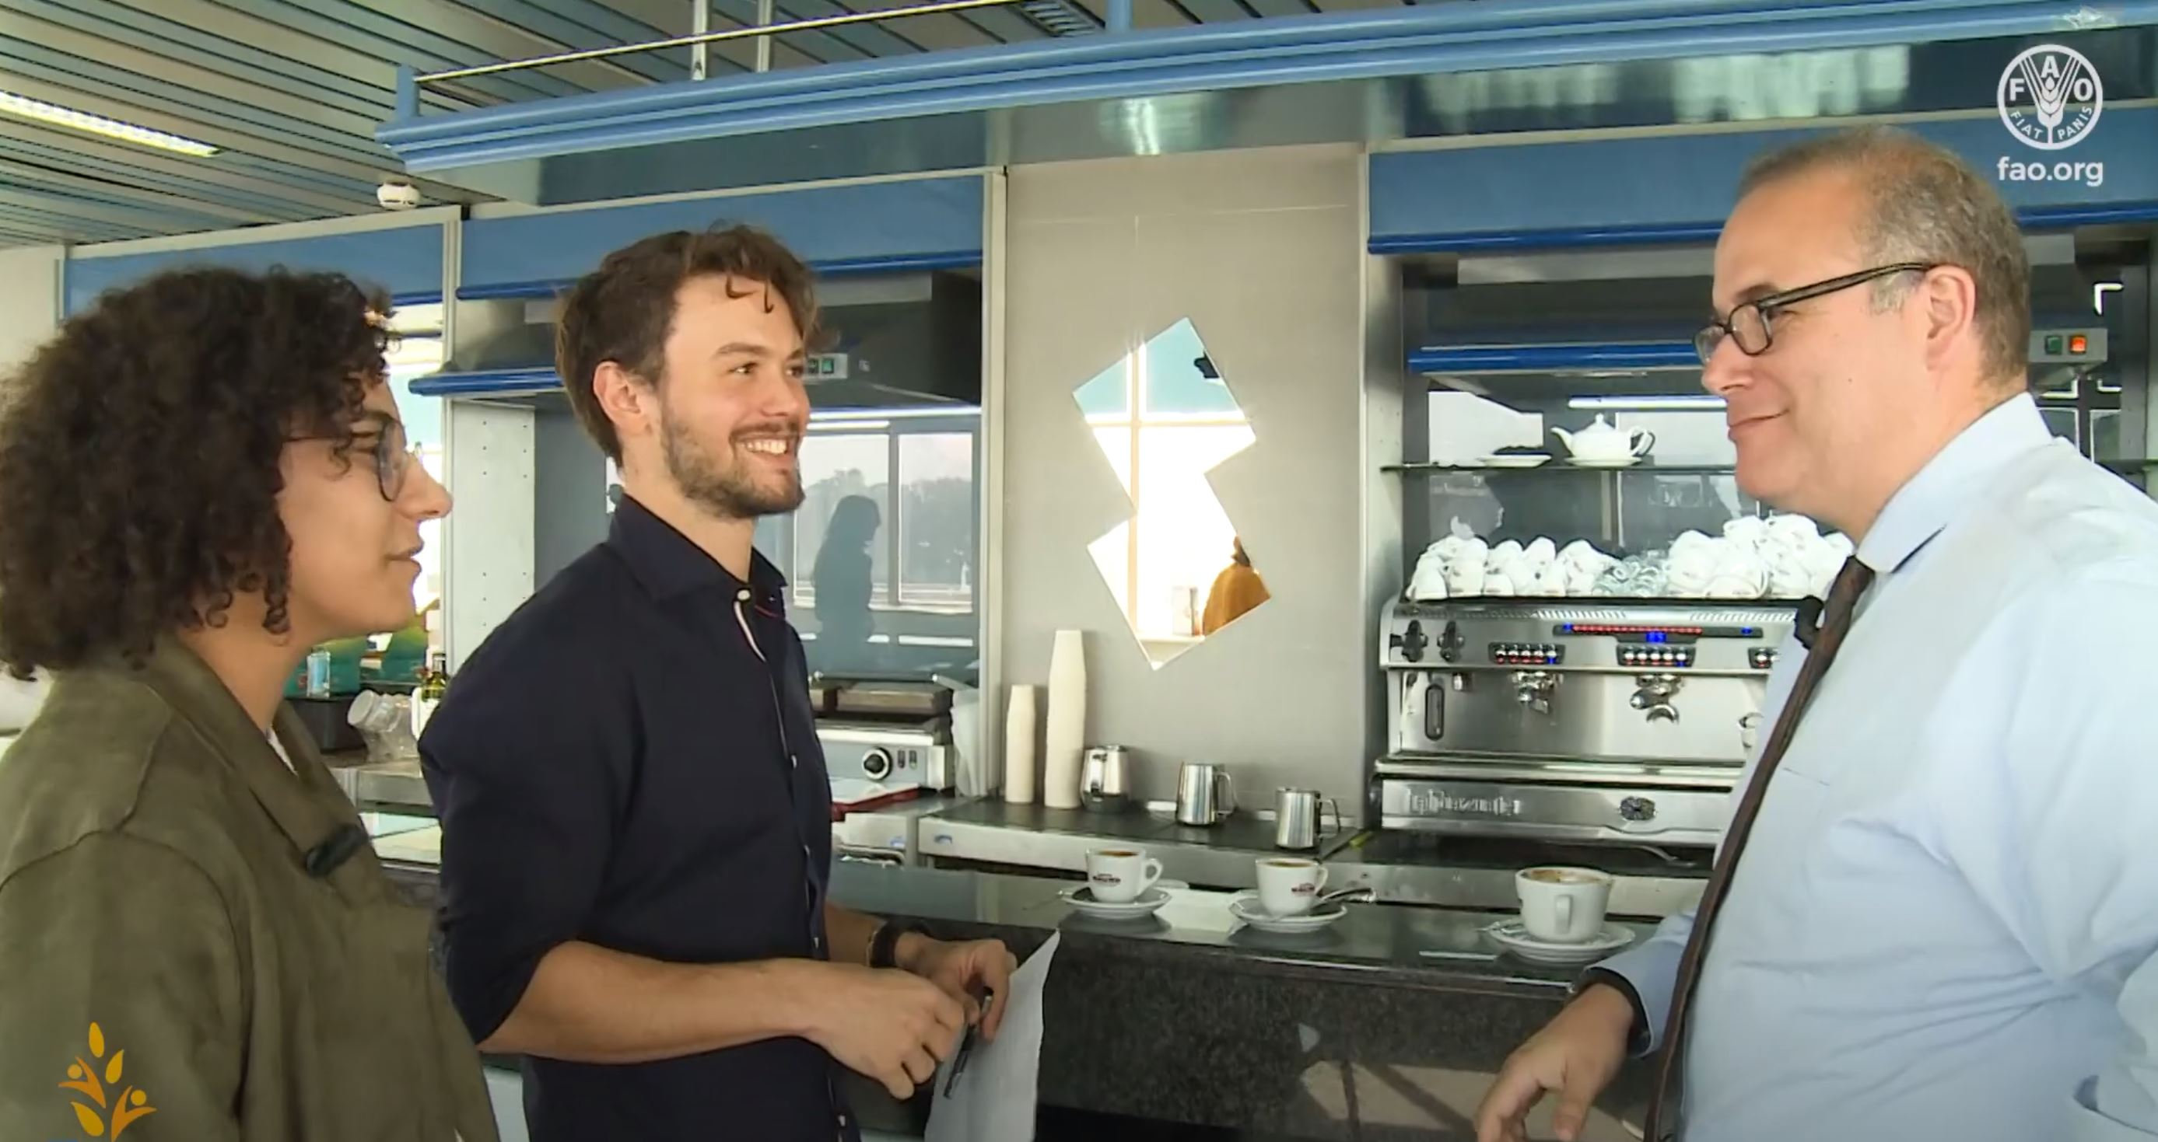
Social Media Posts
Maximo Torero – Chief Economist of the Food & Agriculture Organisation of the United Nations - FAO
Interview with Maximo Torero
EUFIC
@EUFIC
European Food Information Council. Food facts for healthy choices. For news from European research projects
@SciFoodHealth
Credit: FAO https://www.youtube.com/watch?v=LZj04mXXRmI

Slide 13
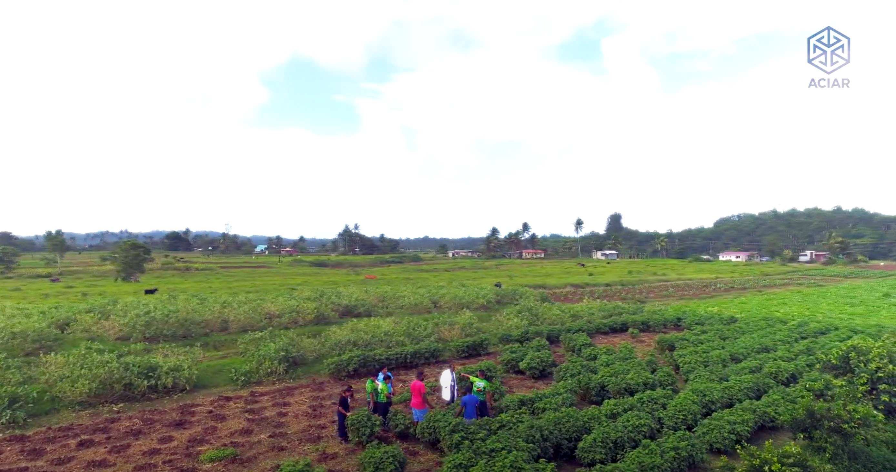
Action by ACIAR
Australian Centre for International Agricultural Research
Training for Plant Health Doctors in the Pacific
How and why is this related to food loss?
https://www.youtube.com/watch?v=ckWmuAvcvlw

Slide 14
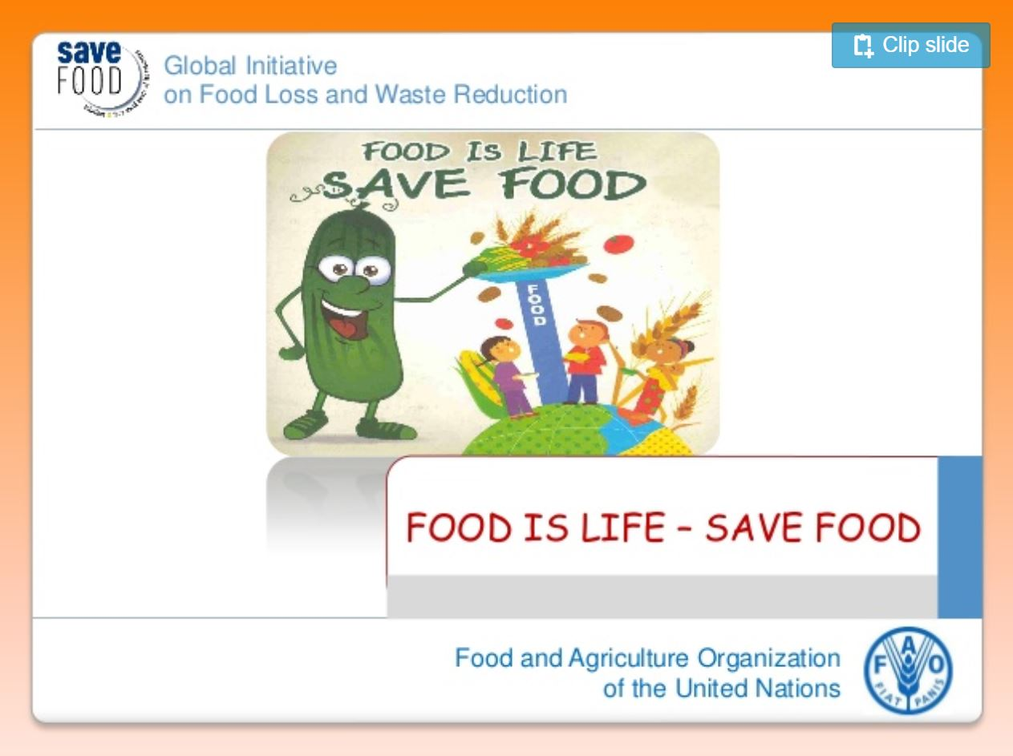
Reducing Food Loss and Waste
View slides and add to your mind map
Food is Life

Slide 15
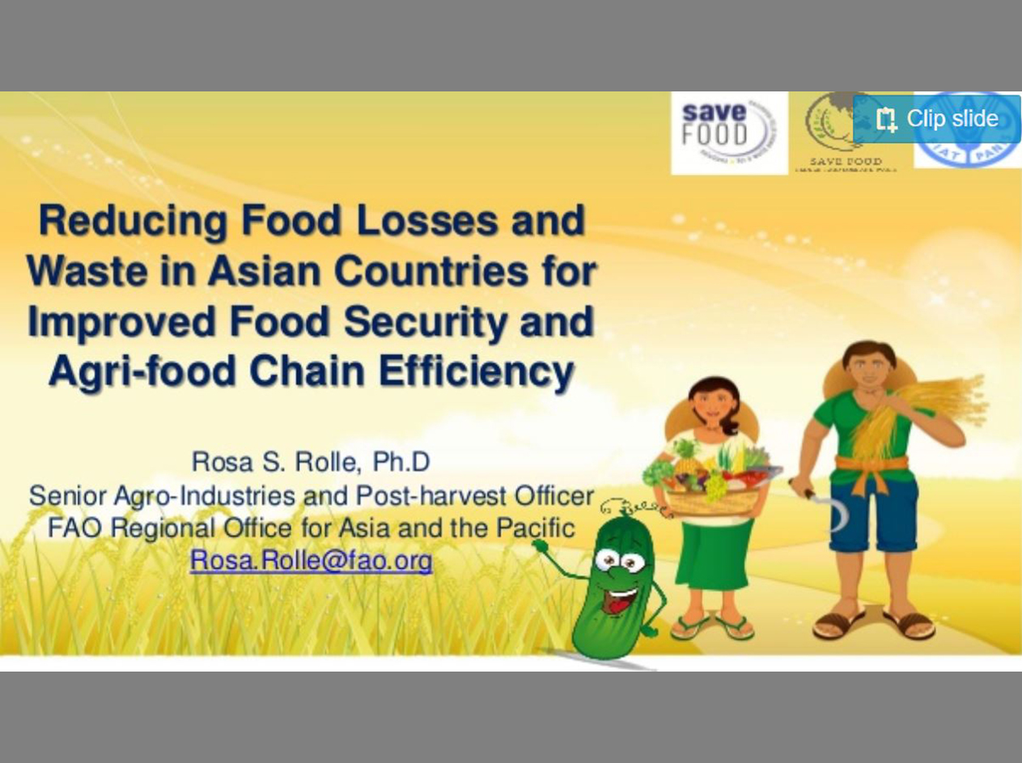
Reducing Food Loss and Waste
View slides and add to your mind map. Analyse data throughout to explain patterns, trends and relationships.
Reducing Food loss and waste

Slide 16
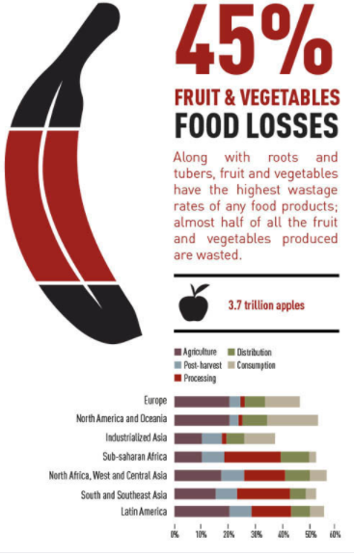
Food and Nutrition Security to support sustainable food systems.
Interpret the infographic and analyse the graph to explain patterns, trends and relationships of fruit and vegetable food losses in the world.
Credit: FAO
http://www.fao.org/save-food/resources/presentations/en/

Slide 17

Did you know?
When reductions in food loss occur close to the farm, they are most effective in addressing food insecurity and in alleviating stress on land and water.
When reductions in food waste occur downstream in the supply chain and at the consumer level they are key to cutting greenhouse gas emissions.
38 percent of total energy consumption in the global food system is utilised to produce food that is either lost or wasted.
Get more info on the website for the UN International Day of Awareness of on Food Loss and Waste Reduction- 29 September https://www.un.org/en/observances/end-food-waste-day/background

Slide 18
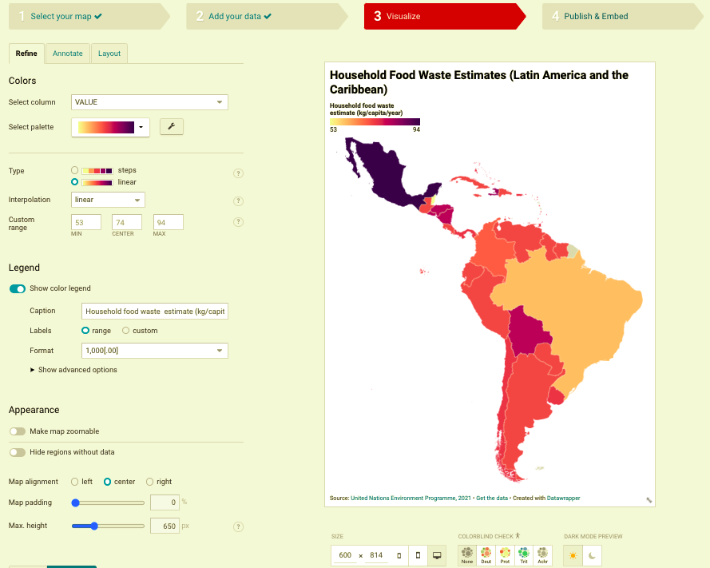
Choropleth mapping
– Example
Create a choropleth map of the Household Food Waste Estimates for Asia using the instructions on the following slides.

Slide 19
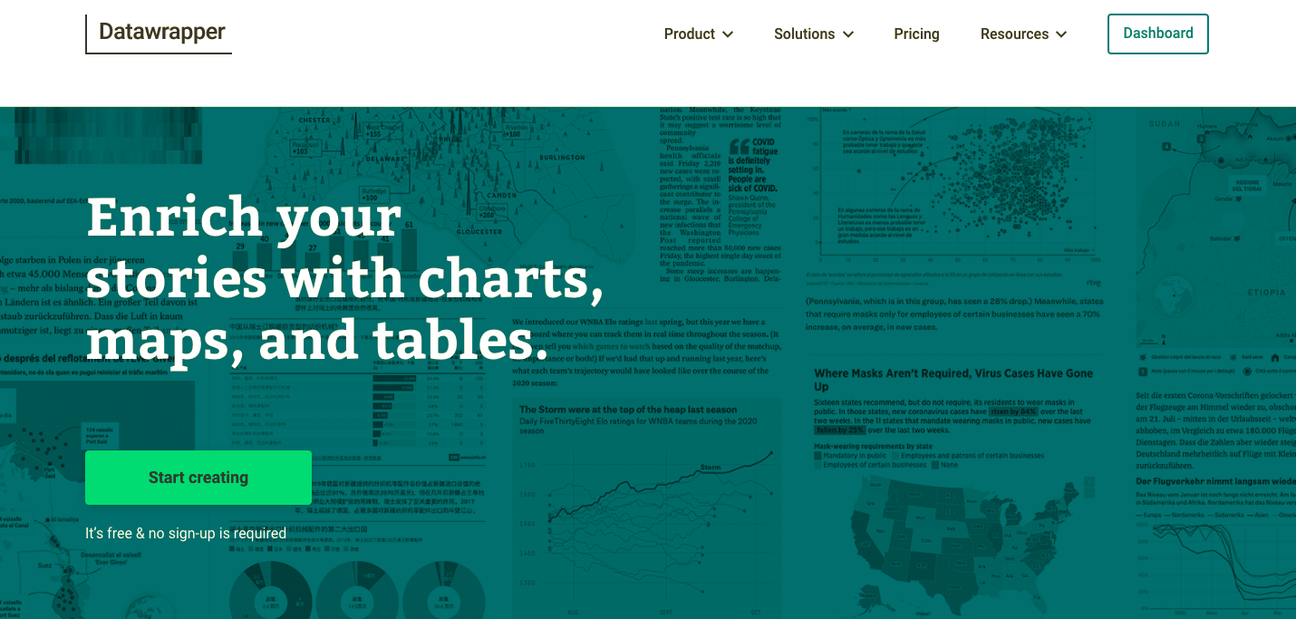
Choropleth Mapping – Example
Step 1 – Go to https://www.datawrapper.de/ and click Start creating

Slide 20
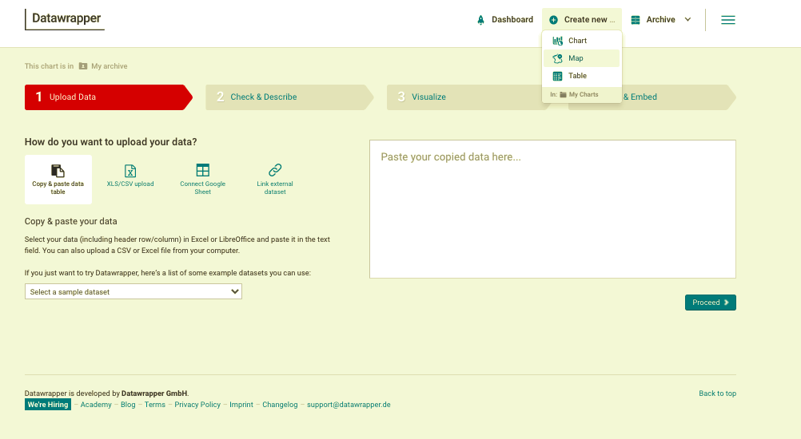
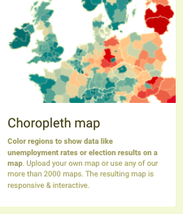
Choropleth Mapping – Example
Step 2 – Select Create new and click Map. On the next page select Choropleth map.

Slide 21
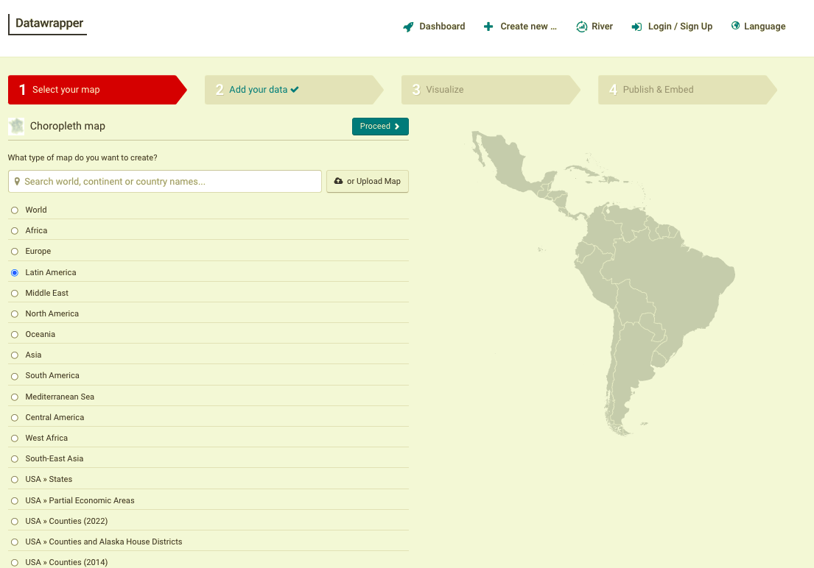
Choropleth Mapping – Example
Step 3 – Select map for Asia

Slide 22
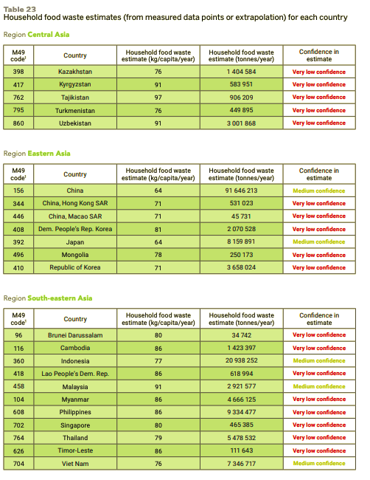
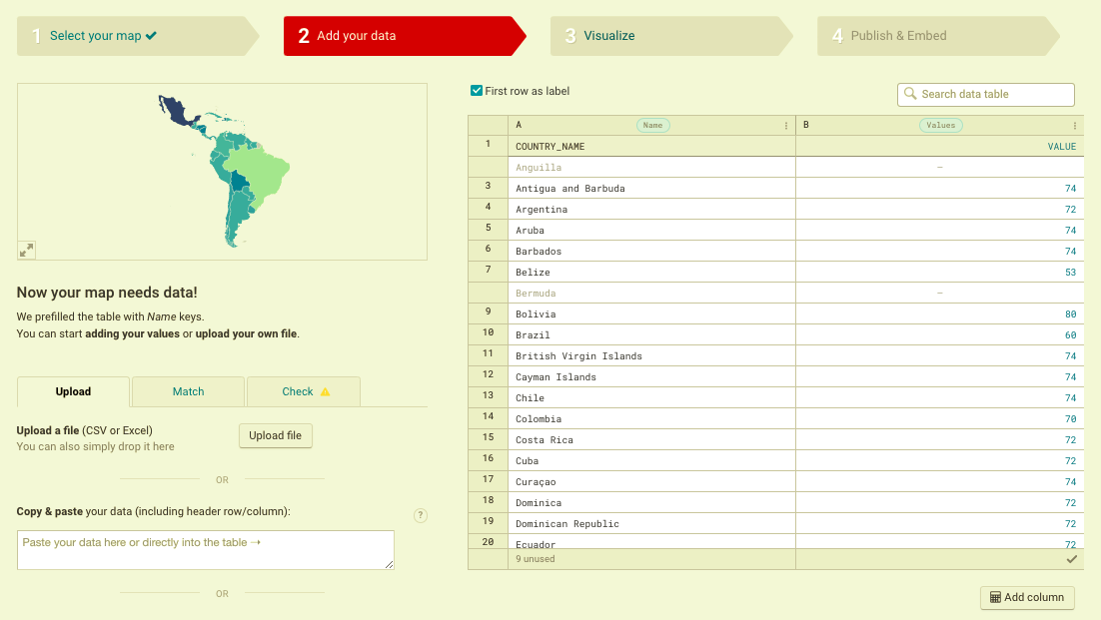
Choropleth Mapping – Example
Step 4 – Add in the raw data from the table. Choose either kg/capita/year or tonnes/year
Source: https://wedocs.unep.org/handle/20.500.11822/35280

Slide 23
Choropleth Mapping – Example
Step 5 – Explore the visualize tab to select colours of your choice and annotate your map.

Slide 24
Choropleth Mapping – Example
Step 6 – Publish your map.

Slide 25
Choropleth Mapping – Example
Step 7 – Interpret your map to explain patterns, trends and relationships.
Example:
The largest amount of food wastage occurs at the northern tip of Latin America with all countries wasting above 80kg/capita/year. The exceptions to this are Belize with 53kg/capita/year and Guatemala with 72kg/capita/year.

Slide 26
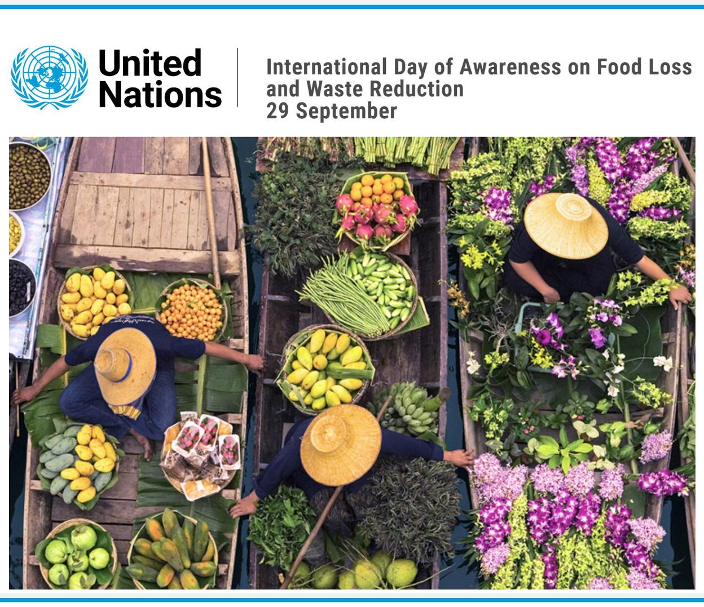
Your Task
Create a media campaign for
The United Nations International Day of Awareness on Food Loss and Waste Reduction - 29 September
Guidelines
Work in pairs or small groups
Identify your target audience - be specific on where you want your message to land.
Select one action or behaviour you want to change or grow an awareness about.
Develop success criteria – how will you know if your campaign is successful?
Produce a media campaign – this could be a video or a PowerPoint (see slide 28 for samples)
Be sure to use data to add depth to your campaign.

Slide 27
Campaign - considerations
Goals
What are you trying to achieve through this campaign?
How will you know when you achieve it?
Target Audience
Who are you trying to reach?
What is the food loss or food waste challenge for this audience?
Key messages
Why does this matter to your audience?
What are the barriers to this audience and how does this solve a problem for them?
Strategies
How will you reach and engage your audience?
Can you offer incentives?
Timing
When would be the best time to reach your audience?
Is it a one off campaign or part of a series?
What data will best represent the key messages?

Slide 28
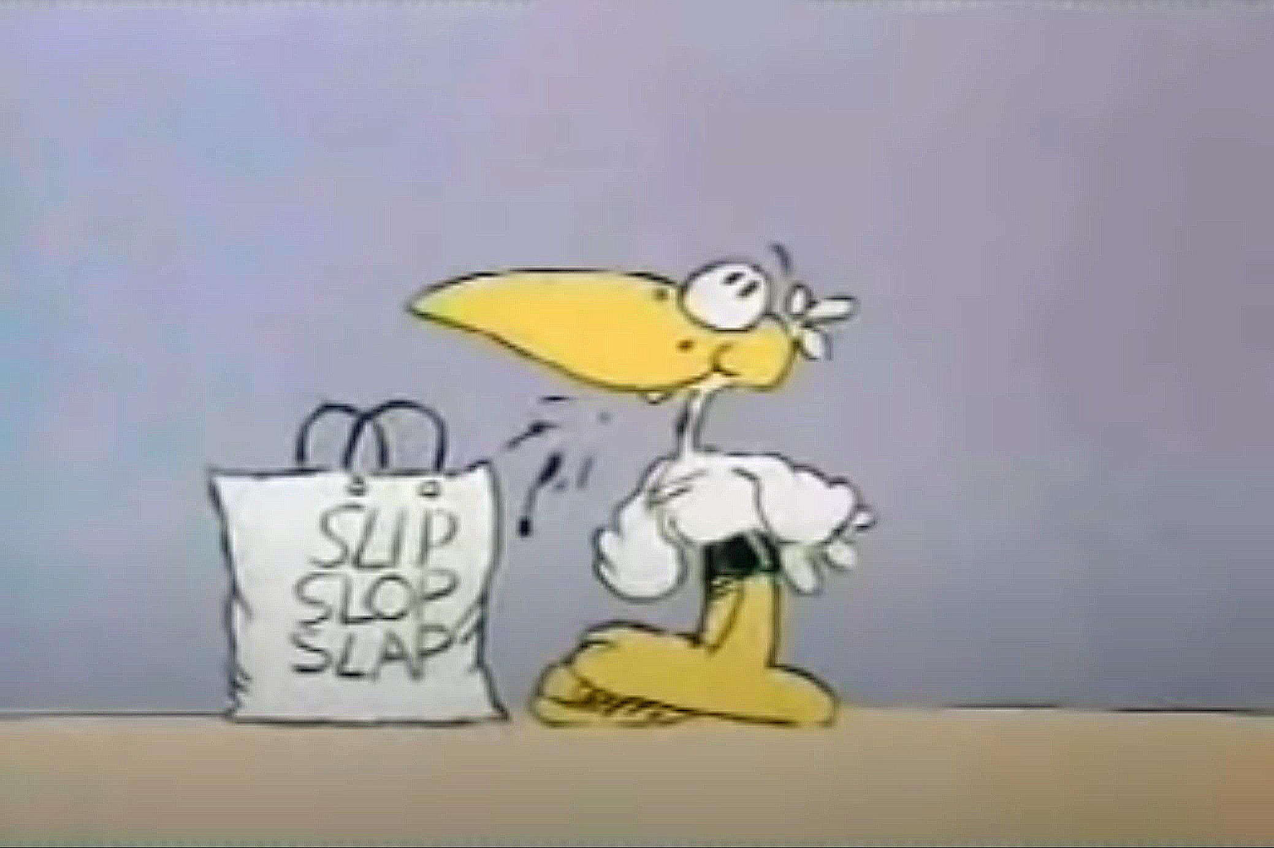
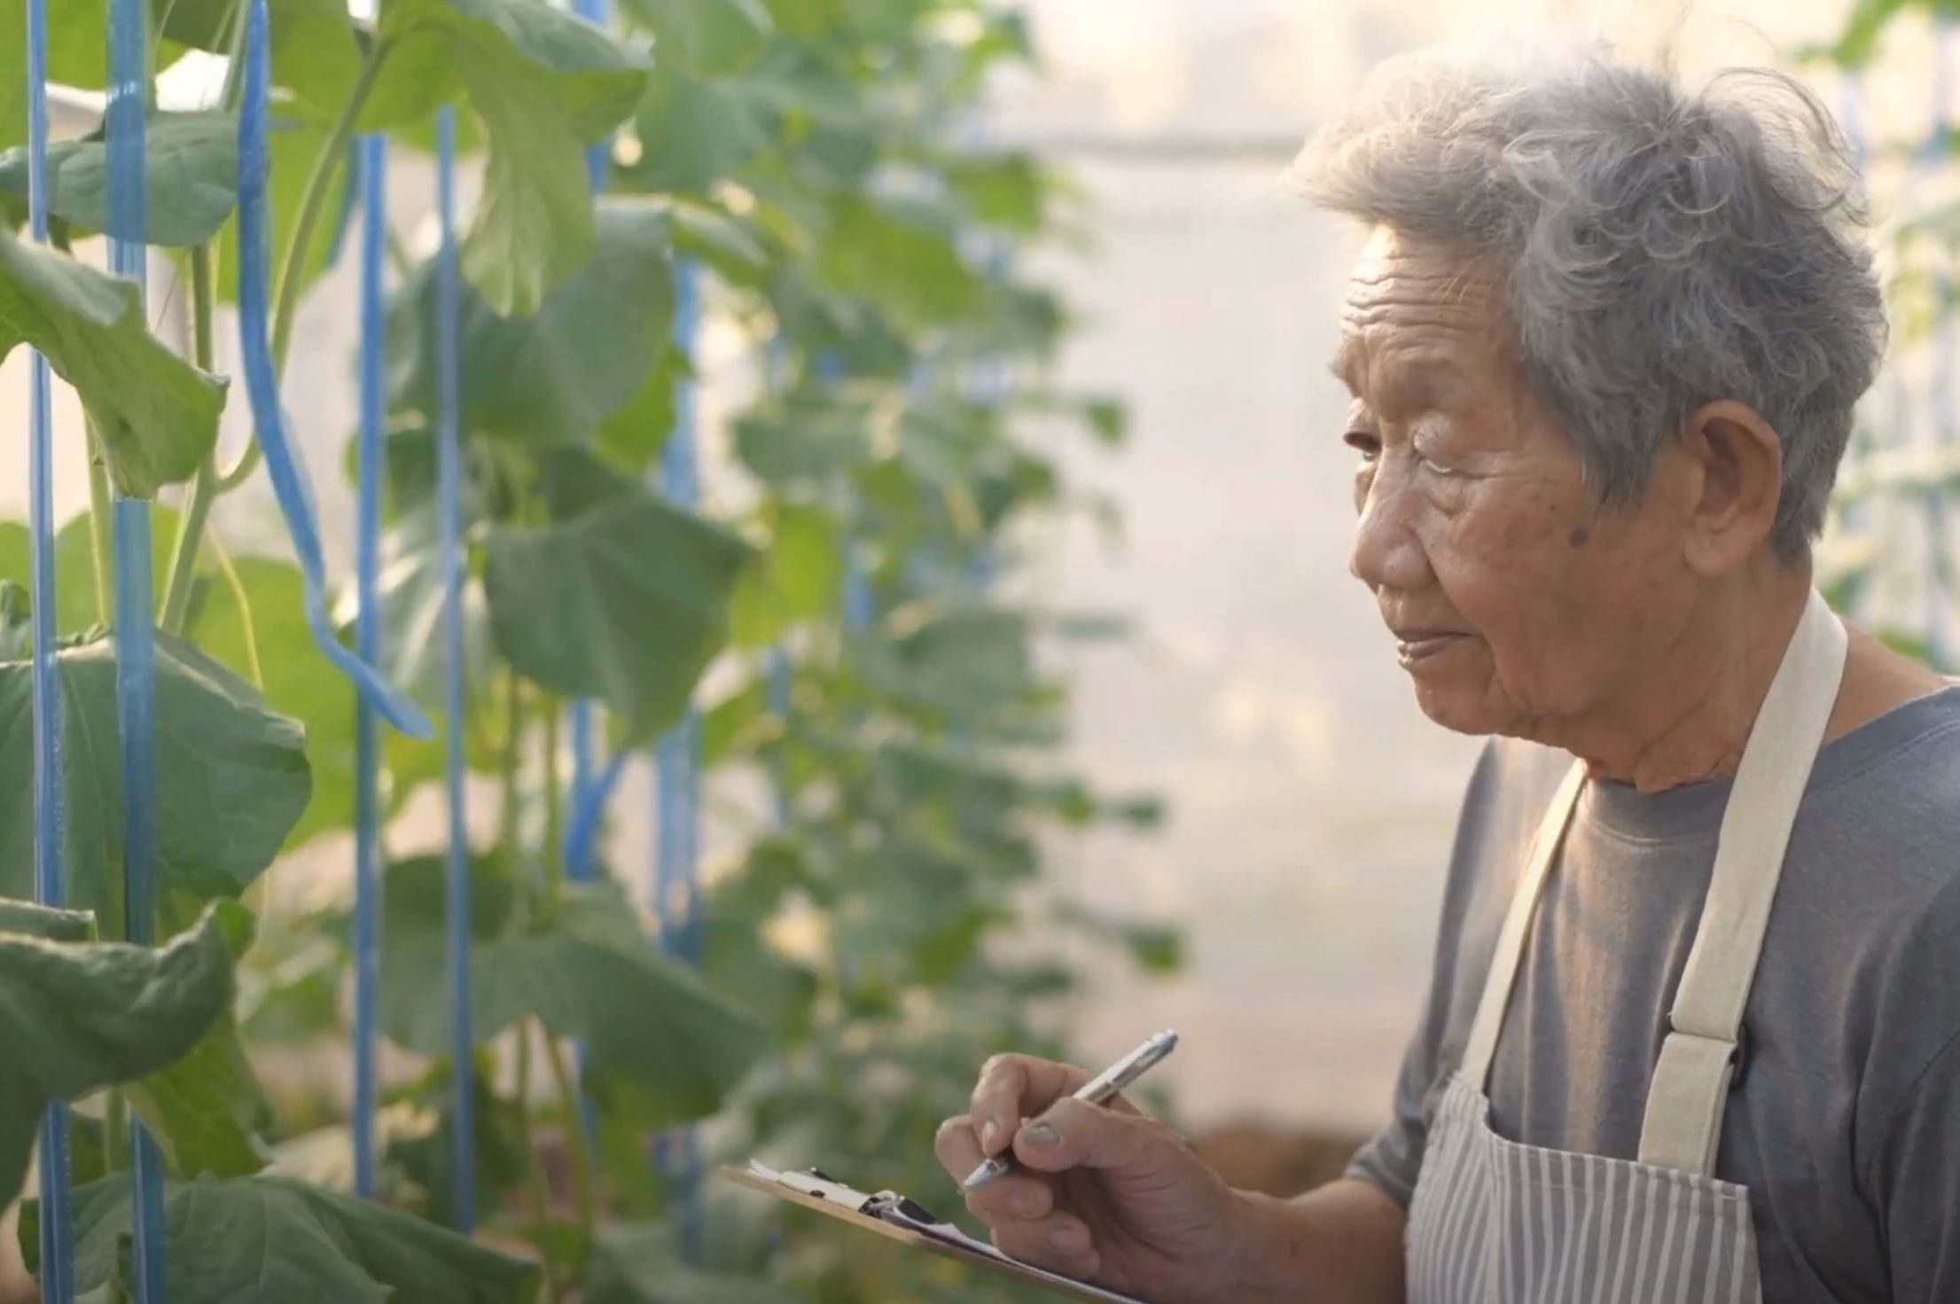
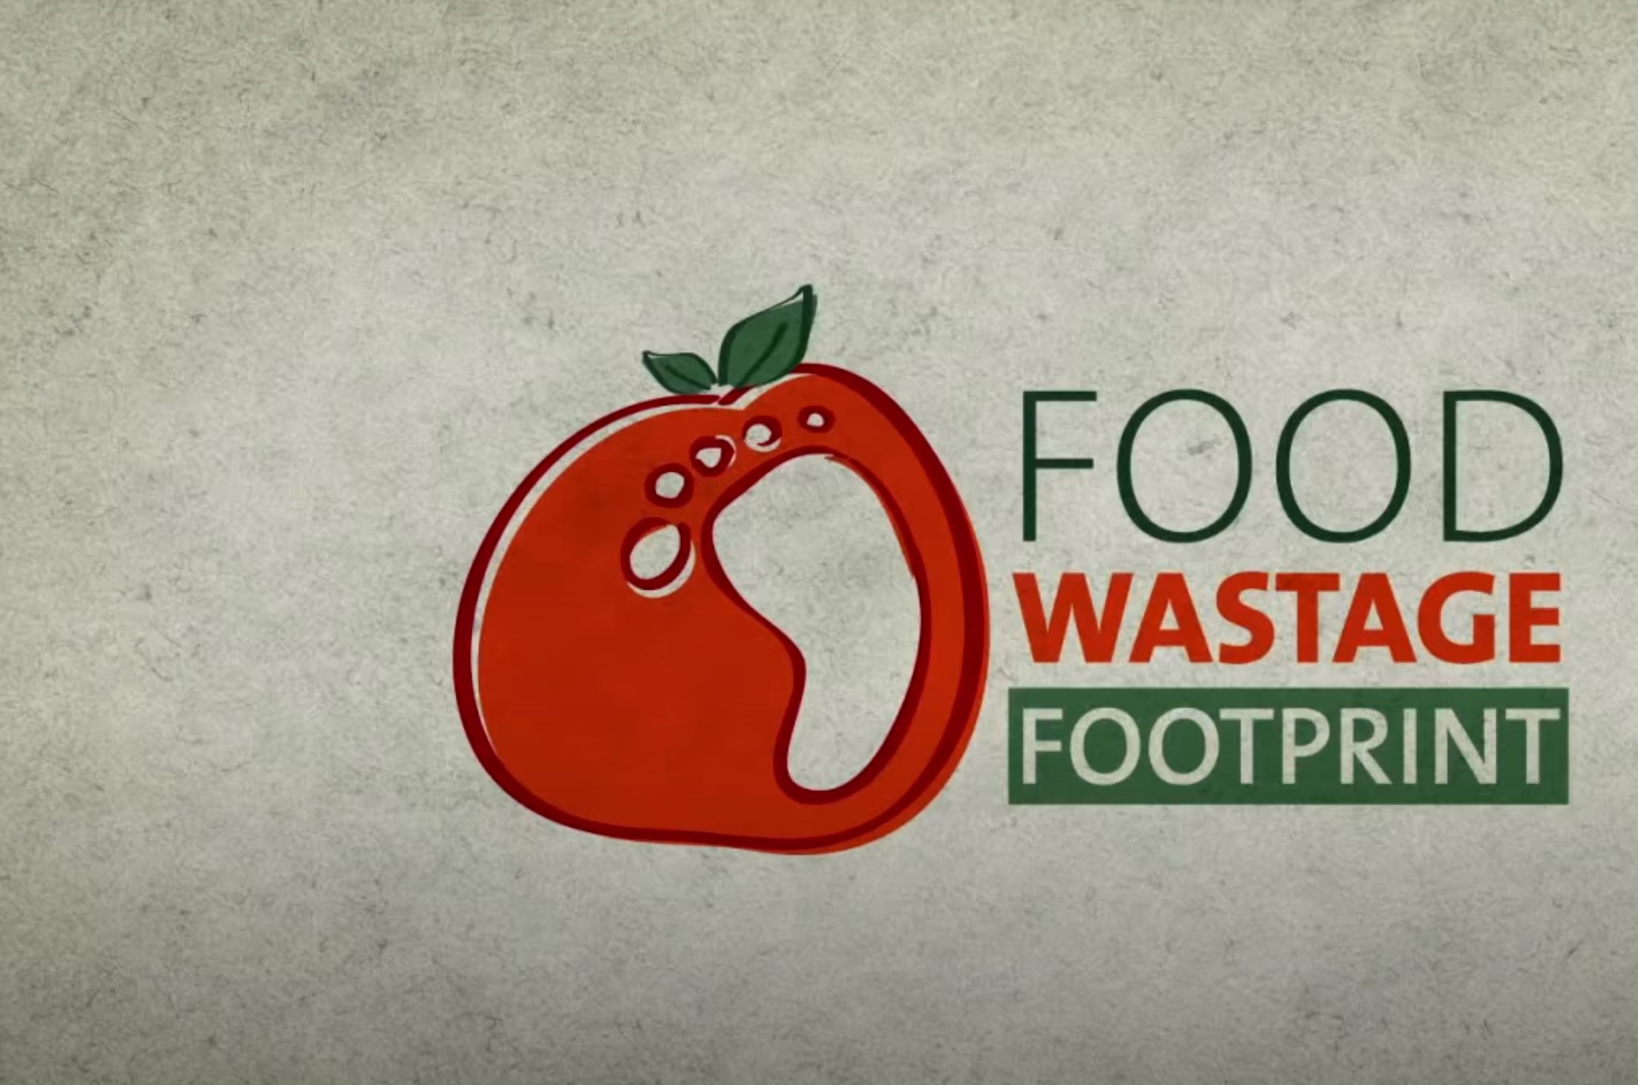
Examples of media campaigns to raise awareness and create change
https://www.youtube.com/watch?v=b7nocIenCYg&t=11s
https://www.youtube.com/watch?v=ZvOMMURrBMY&t=120s
https://www.youtube.com/watch?v=o-MLULKFae4

Slide 29
Module 7: Climate Smart Technologies – campaign Rubric (Geography)
 | A | B | C | D | E
Knowledge and understanding | comprehensive explanation of a food loss and waste reduction behaviour or action | detailed explanation of a food loss and waste reduction behaviour or action | explanation of a food loss and waste reduction behaviour or action | description of a food loss and waste reduction behaviour or action | statements about food loss and waste reduction
 | discerning analysis of the impact of changing the behaviour or action using environmental, social and economic criteria | informed analysis of the impact of changing the behaviour or action using environmental, social and economic criteria | analysis of the impact of changing the behaviour or action using environmental, social and economic criteria | explanation of the impact of changing the behaviour or action using aspects of environmental, social and economic criteria | statements about the impact of changing the behaviour or action
Acquiring geographical information | discerning selection and collection of relevant and reliable geographical information and data | effective selection and collection of relevant and reliable geographical information and data | selection and collection of relevant and reliable geographical information and data | selection and collection of aspects of relevant geographical information and data | selection and collection of limited geographical information and data
Processing geographical information | recording and accurate and detailed representation of data in a range of appropriate digital forms | recording and detailed representation of data in a range of appropriate digital forms | recording and representation of data in a range of appropriate digital forms | recording and partial representation of data in digital and forms | recording and fragmented representation of data
 | discerning interpretation and analysis of maps, data and other information to: propose comprehensive explanations for patterns, trends, relationships and anomalies predict outcomes | effective interpretation and analysis of maps, data and other information to: propose informed explanations for patterns, trends, relationships and anomalies predict outcomes | interpretation and analysis of maps, data and other information to: propose explanations for patterns, trends, relationships and anomalies predict outcomes | Interpretation of maps, data and other information to: propose partial explanations for patterns, trends, relationships and anomalies predict outcomes | statements about maps, data and other information to propose fragmented explanations and predictions
Communicating geographical information | purposeful presentation of findings, arguments and explanations using: relevant geographical terminology digital representations in a range of appropriate communication forms | effective presentation of findings, arguments and explanations using: relevant geographical terminology digital representations in a range of appropriate communication forms | presentation of findings, arguments and explanations using: relevant geographical terminology digital representations in a range of appropriate communication forms | partial presentation of findings, arguments and explanations using: geographical terminology aspects of digital representations in appropriate communication forms | fragmented presentation of findings using: everyday language fragmented digital representations
 | justified prediction of the outcomes and consequences of the media campaign using purposeful success criteria | plausible prediction of the outcomes and consequences of the media campaign using effective success criteria | prediction of the outcomes and consequences of the media campaign using success criteria | prediction of aspects of outcomes and consequences of the media campaign using some success criteria | statement about the outcomes

Slide 30
Resources
Food Loss and Waste
https://www.ifpri.org/topic/food-loss-and-waste
Food loss research program https://www.youtube.com/watch?v=DGfJgrRDUUo&t=2s
Food Loss Research Dialogue
https://www.aciar.gov.au/media-search/events/food-loss-research-dialogue
Four things to know about food loss
https://aciar.gov.au/media-search/blogs/four-things-know-about-food-loss
Why Does Animal-Based Food Loss and Waste Matter? https://academic.oup.com/af/article/10/4/48/5943504
Stop the Waste
https://cdn.wfp.org/2020/stop-the-waste/?utm_source=twitter&utm_medium=social&utm_campaign=202009_stopthewaste&utm_content=post – really good resource
A new International Day with a difficult starting point https://www.un.org/en/observances/end-food-waste-day/background
One-third of all food produced in the world is lost or wasted between farm and fork
https://flwprotocol.org/
Food loss and waste reduction, measurement and policy http://www.fao.org/platform-food-loss-waste/en/
How can food loss and waste reduction best deliver climate benefits
https://ccafs.cgiar.org/news/how-can-food-loss-and-waste-reduction-best-deliver-climate-benefits
Food loss and waste must be reduced for greater food security and environmental sustainability
https://www.unep.org/news-and-stories/press-release/food-loss-and-waste-must-be-reduced-greater-food-security-and
SDG Target 12.3 on Food Loss and Waste: 2020 Progress Report https://champions123.org/publication/sdg-target-123-food-loss-and-waste-2020-progress-report
Reducing Food Loss and Waste: Setting a Global Action Agenda https://www.wri.org/publication/reducing-food-loss-and-waste-setting-global-action-agenda

Slide 31
Projects
Responding to emerging pest and disease threats to horticulture in the Pacific Islands https://aciar.gov.au/project/hort-2016-185
Plant Health Clinic to benefit Samoan farmers
https://aciar.gov.au/media-search/news/plant-health-clinic-benefit-samoan-farmers
Rodent Control (non-chemical) in lowland irrigated rice
http://www.knowledgebank.irri.org/training/fact-sheets/pest-management/rats/rodent-control-non-chemical-in-lowland-irrigated-rice
Beyond Breeding: The potential of improved postharvest storage techniques for smallholder farmers
https://www.cimmyt.org/news/beyond-breeding-the-potential-of-improved-postharvest-storage-techniques-for-smallholder-farmers/
New Program to Cut Food Losses in Low Income Countries
https://aciar.gov.au/media-search/news/new-program-cut-food-losses-low-income-countries

Slide 32



Share your campaign!
Send your ideas or videos to the Crawford Fund – schools@crawfordfund.org.
You may just help reduce food loss or food waste! The Crawford Fund may choose to showcase your work!
Use these tags in your media campaign:
@crawfordfund
@aciaraustralia
#Zerohunger
#NextGenAg4D
#foodloss

Slide 33
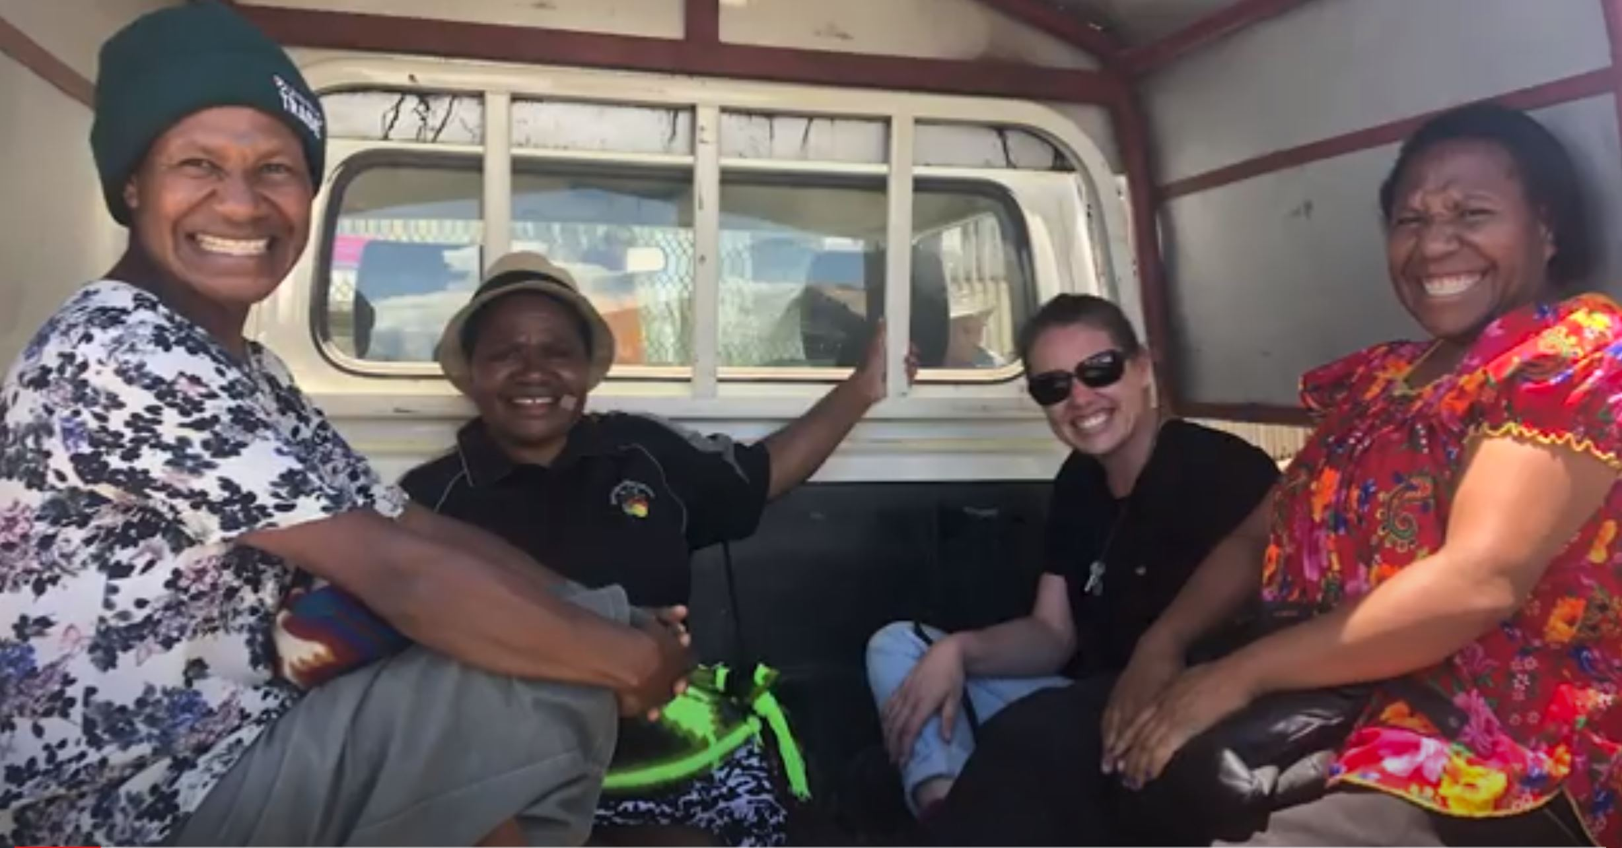
Career Pathways to Agriculture for Development
There are many and varied pathways to agriculture for development, other than by studying agriculture!
https://www.youtube.com/watch?v=60-HXBsad_Y&t=58s

Slide 34
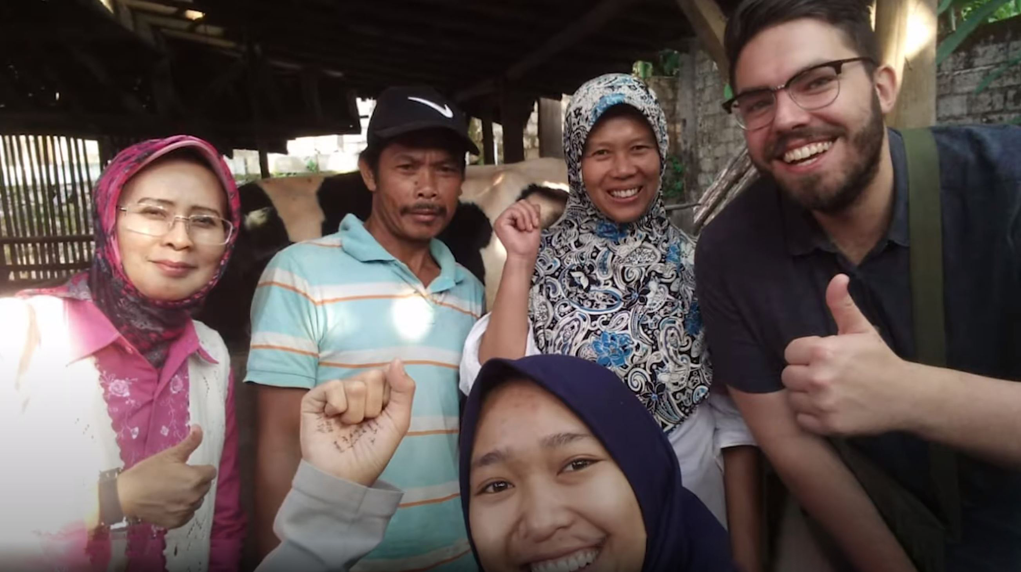
What is the Crawford Fund and what does it do?
The Crawford Fund provides university students with awards to gain experience in developing countries, conference scholarships to learn and be mentored by senior Australian researchers, and opportunities to volunteer in our overseas projects. It also supports Australians in training developing country scientists and farmers and has trained close to 13,500 people in 55 countries.
More info at www.crawfordfund.org and follow @crawfordfund on Twitter, Facebook and Instagram.
Hear from young Australian researchers working in the Asia Pacific Region.
https://www.youtube.com/watch?v=KxVhJ8fDjj4

Slide 35
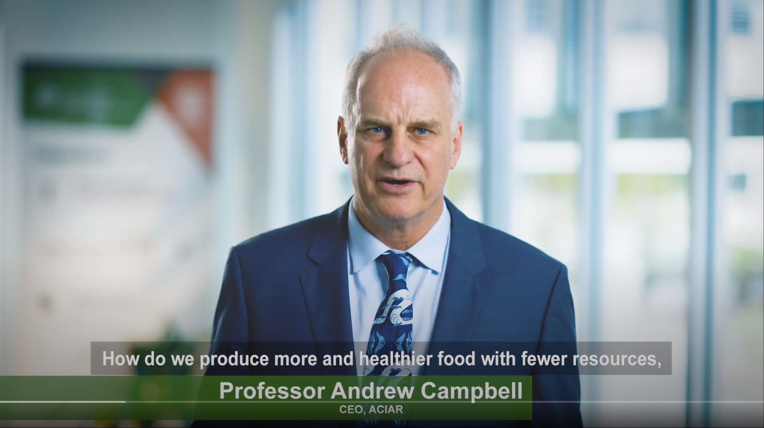
What is the Australian Centre for International Agricultural Research (ACIAR) and what does it do?
ACIAR is the Australian Government’s specialist agricultural research-for-development agency, within the Australian aid program. Its purpose is to contribute to reducing poverty and improving the livelihoods of many in the Indo-Pacific region through collaborative international research which also serves to improve Australian scientific capabilities and the productivity and sustainability of agricultural systems in Australia. More info at www.aciar.gov.au and follow on Twitter, Facebook and Instagram @ACIARAustralia
Learn more about ACIAR in this short video.
https://youtu.be/Mc5-gSTlnY0

Slide 36

Learn more about the Sustainable Development Goals
https://www.un.org/sustainabledevelopment/student-resources/

Slide 37
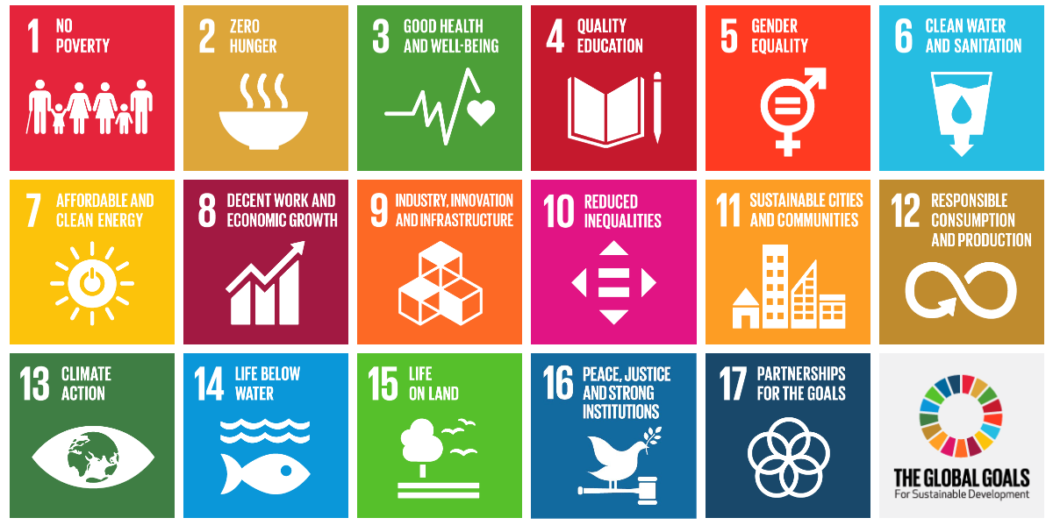
Sustainable Development Goals
https://worldslargestlesson.globalgoals.org/

Slide 38

Credits
These teaching materials are part of the Crawford Fund’s NextGen program, to encourage the next generation into studies, careers and volunteering for global food and nutrition security. Further information is at www.crawfordfund.org and additional teaching materials are available by contacting us at schools@crawfordfund.org
The Crawford Fund and our NextGen project is supported by the Australian Centre for International Agricultural Research. More information on ACIAR is available at www.aciar.gov.au
This resource was developed by Heather MacDonald, Director of Education Partnerships (Schools) Pty Ltd. www.educationpartnerships.com.au

